Slide 1
Coursera Capstone
Ideal location for Aesthetics
A Recommender

Slide 2
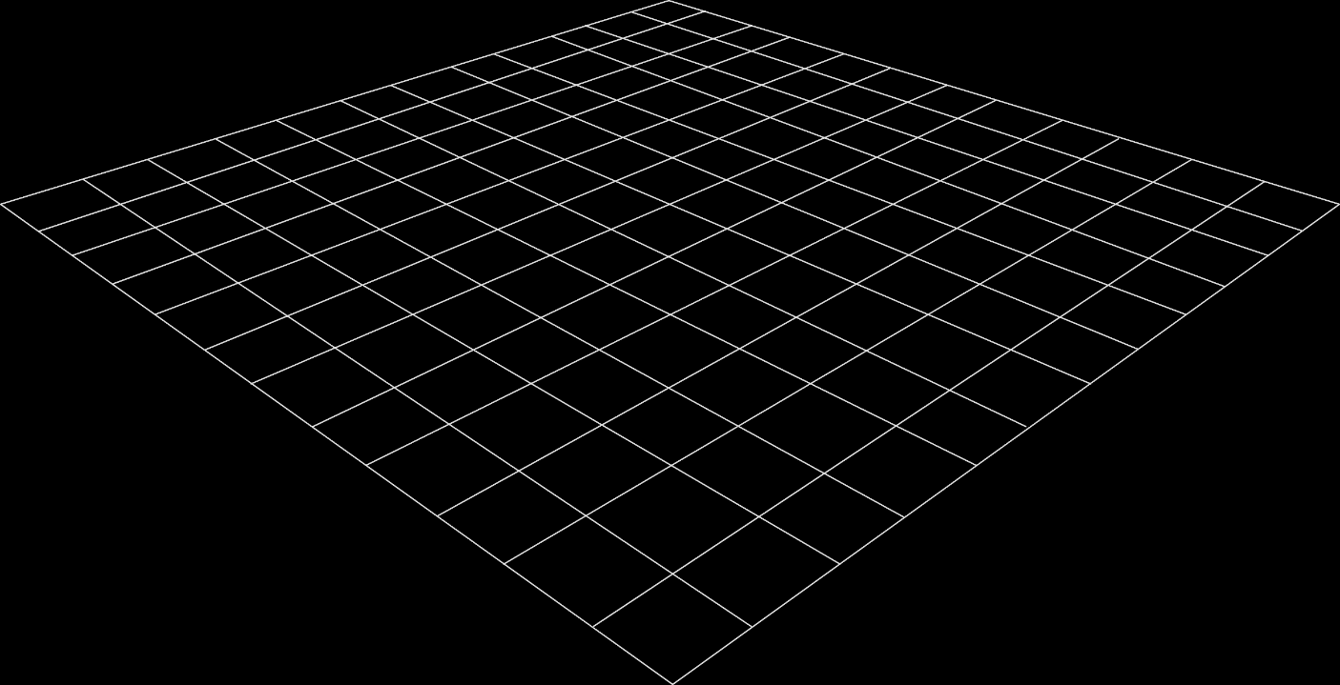
Introduction
Aim of this project is to build a recommender system to discover neighbourhoods and its venues. This recommender system is based on clients' choice of profession and to choose a neighbourhood that may be profitable in the near future.
Our client needs a Recommender system based on the immigrant’s professional interest as the first criteria. Here we will explore the profession of Aesthetician.

Slide 3
Business Problem
As one plans to move to a new neighbourhood, we tend to look for websites providing various details. The details are mostly scattered around many websites.
A brief Intro about Aestheticians: Aestheticians are state licensed health and wellness professionals. Aestheticians must complete a course of training and/or education and pass specific state written and practical examinations to earn licensure through their state board of cosmetology or department of health.
To outperform in the battle of websites, our client needs to add a Recommender System in their website. Currently the website allows searches such as apartments for rents in a certain neighbourhood. As the client is experiencing visitors, who are Aestheticians by profession and would like to move to a neighbourhood based on number of similar profession and needs to be close by to nails/barber/hairdresser facilities, so as to draw more customers. This Recommender System would facilitate the visitor’s search experience, and choose a Borough based on the criteria of Aestheticians. After choosing the borough, the client will be able to look at the neighbourhoods with its amenities, towards choosing a neighbourhood for moving.

Slide 4
Data Inputs
To provide quality information meeting the client’s requirements, we need to access following different data sources:
Bodysafe Data : An open source dataset provided by City of Toronto.
https://open.toronto.ca/dataset/bodysafe/
This dataset provides the most current inspection results for establishments that provide hairdressing/hairstyling, barbering, tattooing, micropigmentation, ear and body piercing, electrolysis, manicure, pedicure and aesthetics services. Inspection data history is limited to the past two years.
This dataset contains data about:
Establishment names and location
Inspection results
Possible infractions and enforcement info
FourSquare: An open source API for proving information about venues and current trends.
Wikipedia : Here we find all the Boroughs and its neighborhood data.

Slide 5
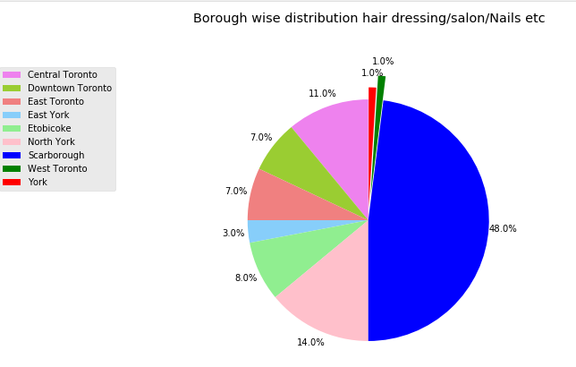
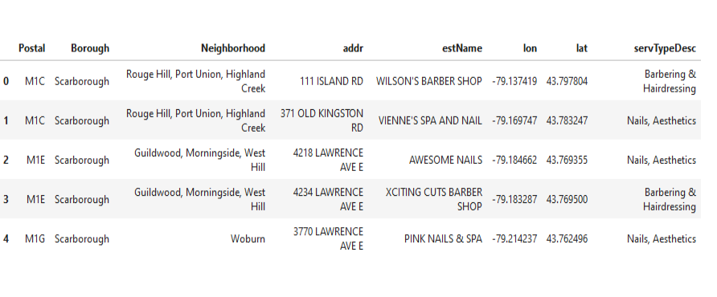
Methodology
Firstly, we take data from Wikipedia to find all the boroughs and neighbourhoods in Toronto city, with respective postal codes. Just like the lab, we did.
We read data into a dataframe from City of Toronto regarding all licensed establishments offering Aesthetics, Nails, hairstyling and barbering services. The following dataframe and corresponding pie chart shows the profession’s distribution.

Slide 6
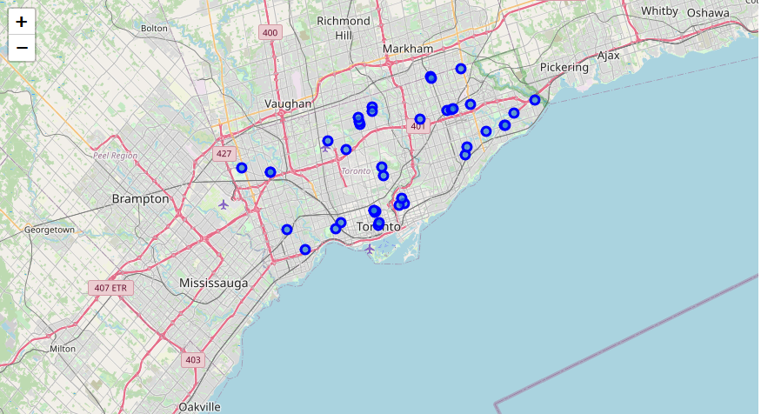
As we can see that from the following Toronto map (with the help of Folium maps), that such licensed establishments offering hairstyling or barbering services are pretty scattered.

Slide 7
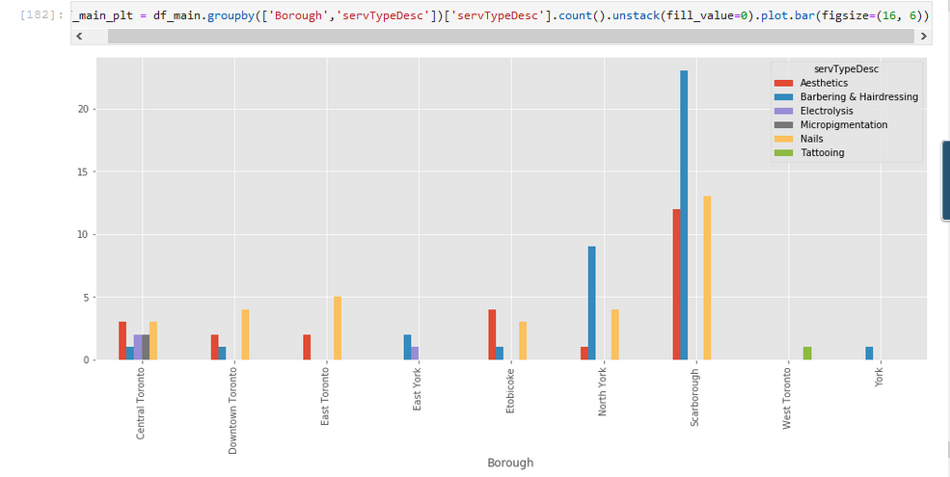
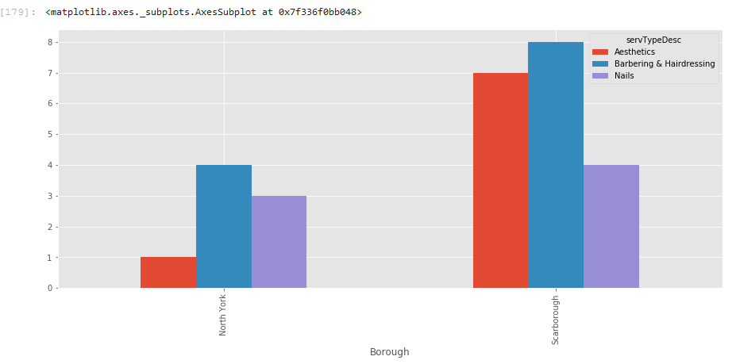
The following chart shows that, borough ‘North York’ has the least number of Aestheticians among the boroughs with at least 1 available.
Among 2 boroughs, North York and Scarborough, the choice would be North York, it has lesser number of Aestheticians. The above graph on the right shows a close comparison.

Slide 8
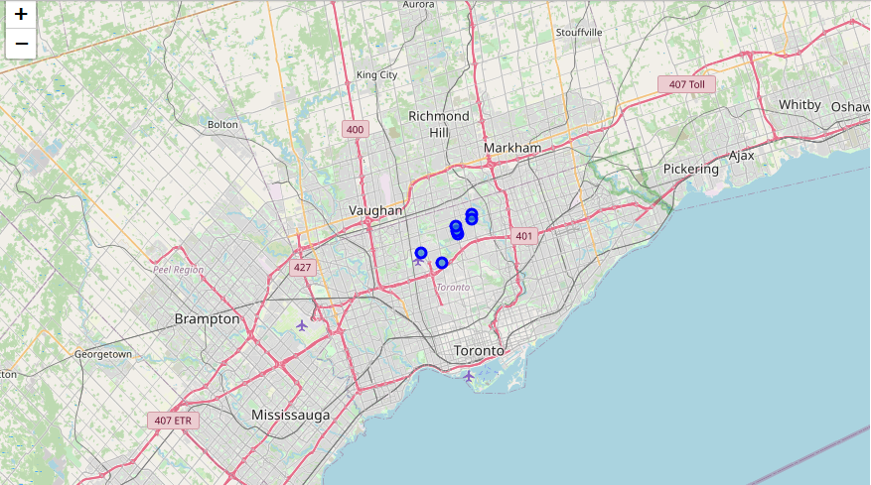
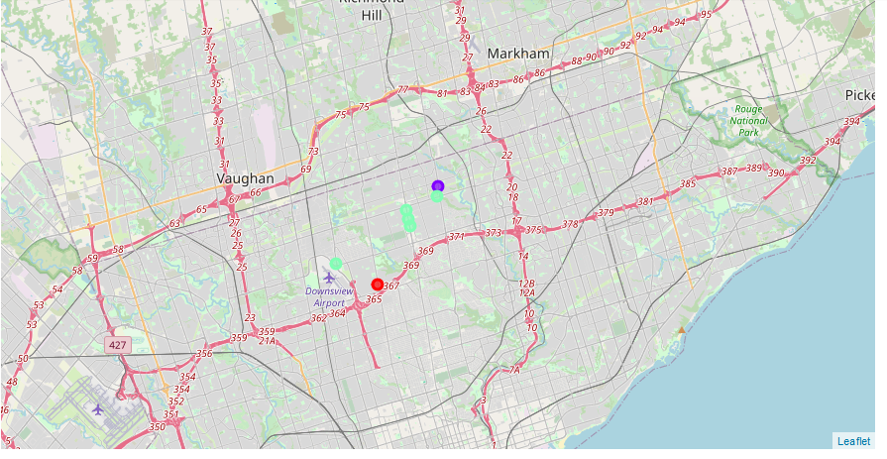
Folium maps helps to display North York neighbourhoods in the following map on the left. With the help of Foursquare API, we explored various venues in the North York Borough.
With the help of k-means cluster, we create dataframes and clusters based on already present barbershop, Nails or any such facilities with their addresses. The map on right, shows the clusters, which narrows down the choice of neighbourhood, as per the visitor’s criteria.

Slide 9
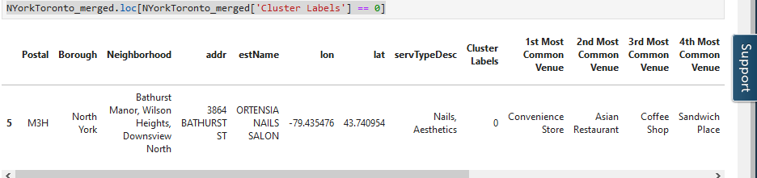
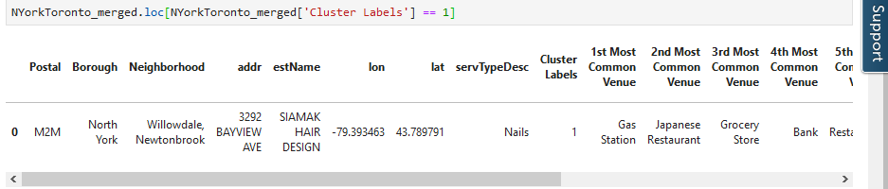
Results
The dataframe resulted in 3 clusters
Cluster 0: This cluster has venues such has convenient store, restaurants, coffee shops etc. It also has neighbourhoods at the same postal code area. It only has 1 similar professional establishment.
Cluster 1: This cluster has venues such has gas station, restaurants, bank etc. and only has 1 similar professional establishment.

Slide 10
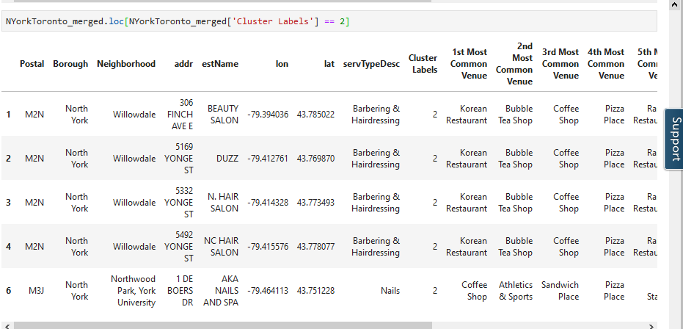
Cluster 2 :This cluster has most neighbourhoods with common venues such has restaurants, Bubble tea shop, coffee shop etc.

Slide 11
Discussion
The aim of the project is to help Aestheticians who want to relocate to Toronto. As Toronto is a very diverse and big city, one needs to research a neighborhood, before moving, specially taking account of their professional growth.
Here we looked into the neighborhood of ‘North York’ borough. There is quite a good venue choice. Such as cluster 2, has more venues and neighborhoods comparison to others. It also has similar professional establishments, where a new Aesthetician can draw more clients and grow professionally.
The preference of venues vary from person to person as every professional need is different.

Slide 12
Conclusion
This project helps an aesthetician to get a better understanding of neighbourhoods, considering professional growth and common venues. It is always helpful to get an insight, before making a decision.
The future of the project includes, other factors as filters, such as, cost of living, transportation and other necessary amenities.

